Slide 1
Intelligent Data Visualization for Cross-Checking Spacecraft System Diagnoses
Presented at: AIAA Infotech@Aerospace 2012
Culver City, CA
June 21, 2012
Authors: Jim Ong, Emilio Remolina, David Breeden,
Brett Stroozas, John L Mohammed
Project sponsor: NASA

Slide 2
Project Overview
Motivation
Project Goal
Future space missions will require automated system management.
Diagnostic reasoning systems are fallible when problems lie outside its expertise.
Cross-checking enables crew to consider alternate diagnoses and analyze evidence.
Cross-checking improves diagnostic accuracy and increases trust in automation.
Develop intelligent data visualization software that helps users cross-check automated diagnostic reasoning systems more quickly and accurately.
Notes:
Jim 1

Slide 3
Test Data: Diagnosis Competition (DxC 09)
Commands
Injected faults
Sensor data
ADAPT Testbed
Diagnostic Algorithms (DAs)
DA Diagnoses
Intelliviz
Notes:
Jim 1

Slide 4
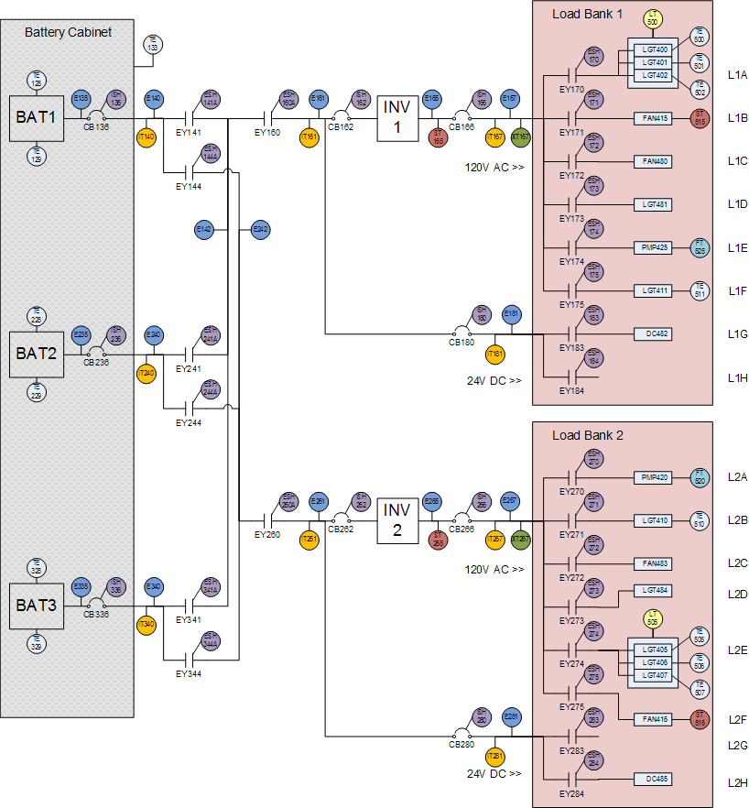
DxC: ADAPT Electrical System Testbed
Notes:
Jim 1

Slide 5
Intelliviz Development Process
Developed Baseline Data Viz Software
Manually Cross-Checked Diagnoses
Identified Cross-Checking
Strategies and Heuristics
Enhanced Analyses and Visualizations
Developed Intelligent Diagnostic Assistance
Notes:
Jim 1

Slide 6
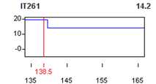
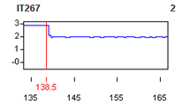
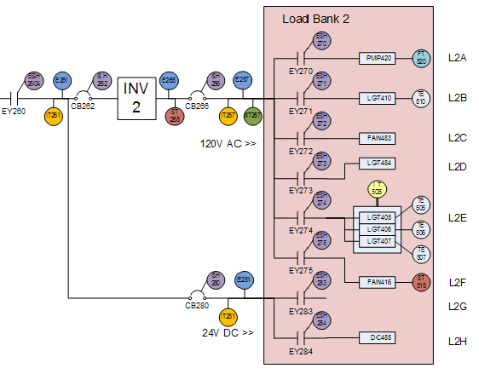
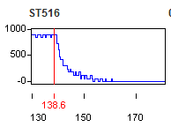
DxC: Exp #824 Diagnoses, Symptom
Auto Dx = Fan
Alt Dx = Relay
Alt Dx = Fan Speed Sensor
Notes:
Jim 1

Slide 7
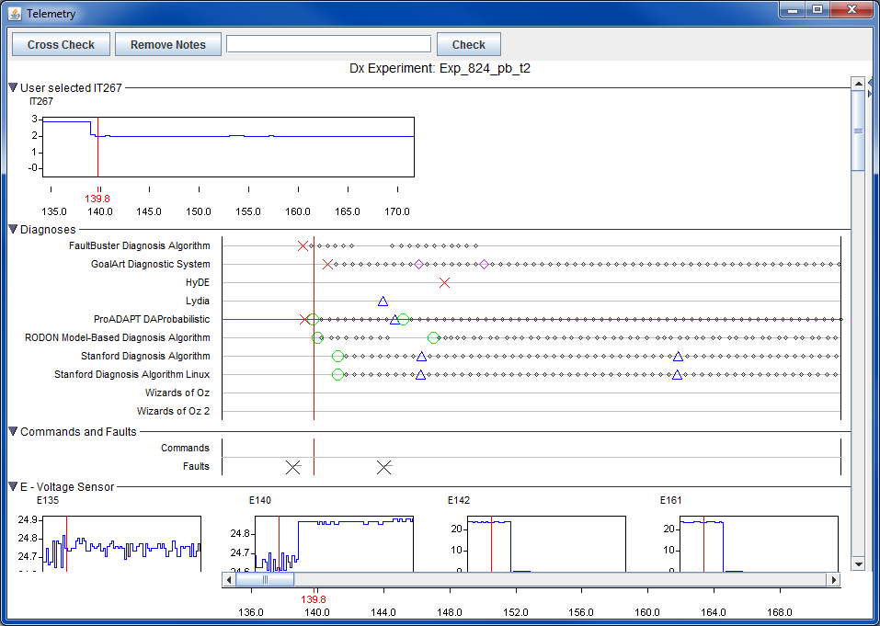
Initial Time-Oriented Data Display
Notes:
No comments

Slide 8
DxC: Cross-Checking Heuristics
Prioritize diagnoses and cross-checking
Identify symptoms underlying diagnosis
Assess plausibility of symptoms
Recognize sensor reading signatures.
Understand the reasoning behind the original diagnosis.
Hypothesize and evaluate alternate diagnoses.
Understand the overall pattern of problems and events.
Look for abrupt changes
Consider earlier events if necessary.
Notes:
Jim 1

Slide 9
DxC: Cross-Checking Heuristics (2)
Search for components that might cause a component to misbehave.
Search for possible causes that are near the symptoms.
Check other sensor data for consistency with candidate fault.
When explaining symptoms, consider specific failure modes.
Divide and conquer
Compare component’s behavior with reference values and relationships.
Compare component’s behavior with a similar component’s.
Exploit physical constraints.
Notes:
Jim 1

Slide 10
DxC: Interactive Analysis, Visualization
Automated Data Change Detection
Filter Data By:
Color-coded schematic
Detect and highlight abrupt changes in value, slope, variation
Change in value, slope, variation
Location w/rt selected component (upstream, downstream, sibling, cousin)
User-specified distance
Sensor type: current, voltage, etc.
Shows spatial patterns of sensors that satisfy filter criteria
Notes:
Jim 1

Slide 11
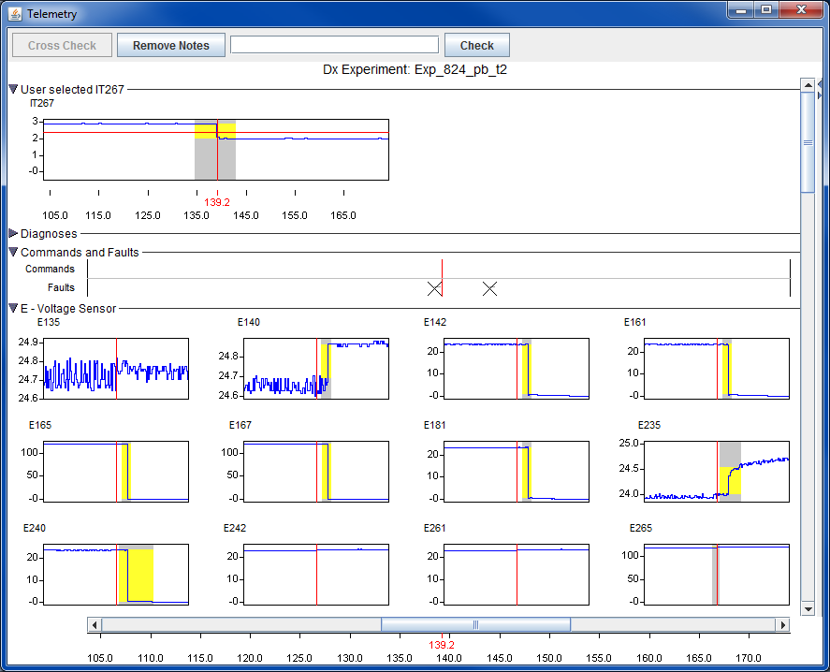
Automated Change Detection
Sensor selected in schematic
Automatically detected changes
Notes:
No comments

Slide 12
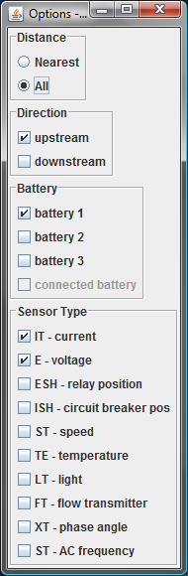
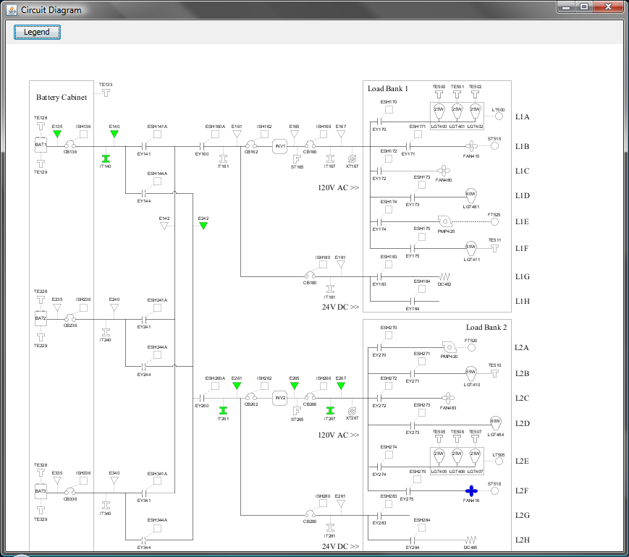
ADAPT Interactive Schematic Display
Color-coding highlights selected components and sensors
Sensor selection criteria
Notes:
No comments

Slide 13
Intelligent Data Visualization Assistant
Context
Sensor Data
Hypotheses, Data Patterns, Rationale
Pattern Detection
Data Visualization
Spatial-Temporal Data Displays
Rationale
Display

Slide 14
Diagnostic Rules
Symptom A
Symptom B
Diagnosis 1
DA Diagnosis
Diagnosis 2
Data Pattern C
Data Pattern D
Symptom Rules
Find data patterns the original Dx might explain
Hypothesis Rules
Find alternate Dxs that might explain a symptom
Find patterns that support or rebut Dxs.
Support Rules
Notes:
No comments

Slide 15
Example Symptom Rule
IF The DA Diagnosis is: a CIRCUIT-BREAKER failed in mode STUCK-CLOSED, and The following data pattern is present: There is a sensor of type CB-POSITION-SENSOR that is linked to the CIRCUIT-BREAKER and There is a data patterns for the sensor variable: EXISTS_VALUE CLOSED and The start time of the sensor data pattern precedes the hypothesis by less than 5 seconds. THEN assume that the DA diagnosis might have been generated to explain this data pattern (symptom).
Notes:
No comments

Slide 16
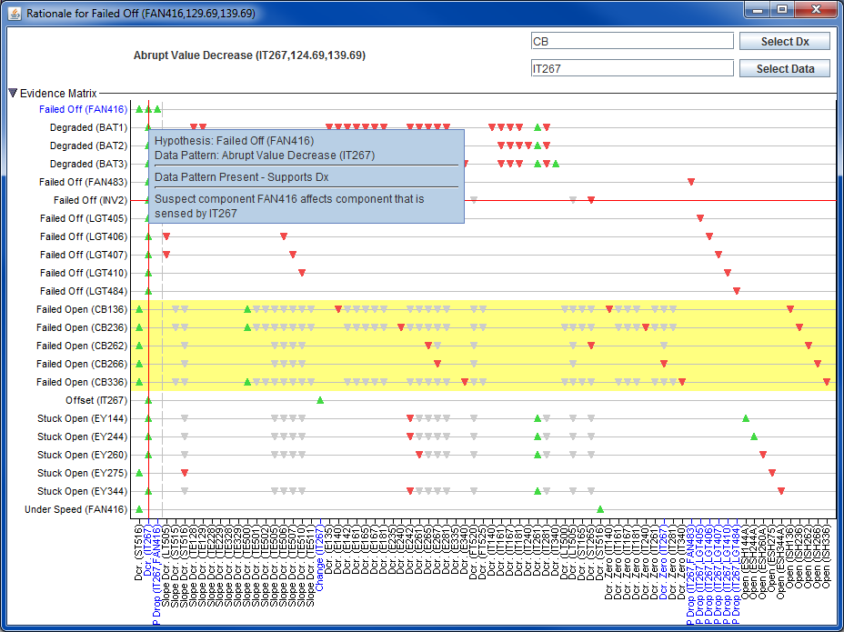
Diagnostic Rationale Matrix
Notes:
No comments

Slide 17
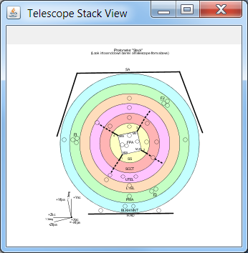
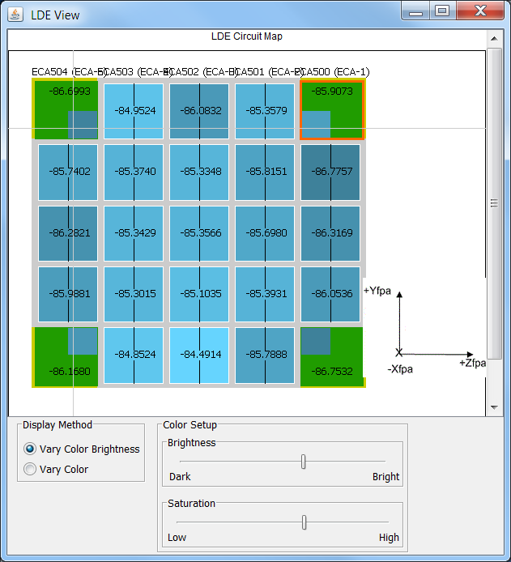
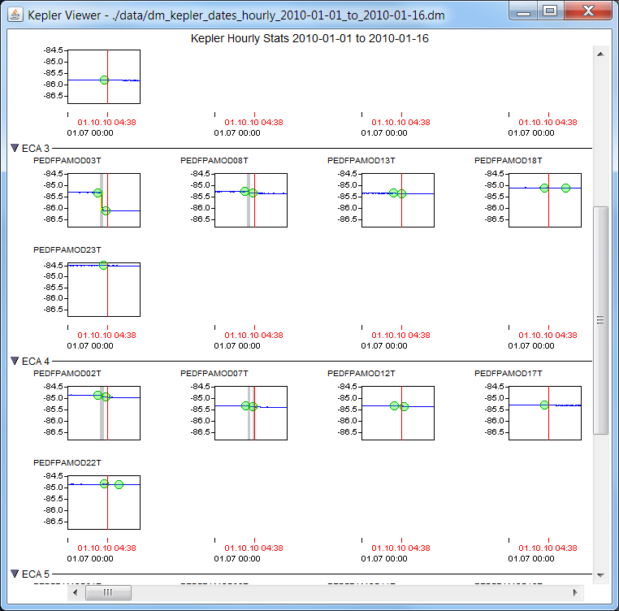
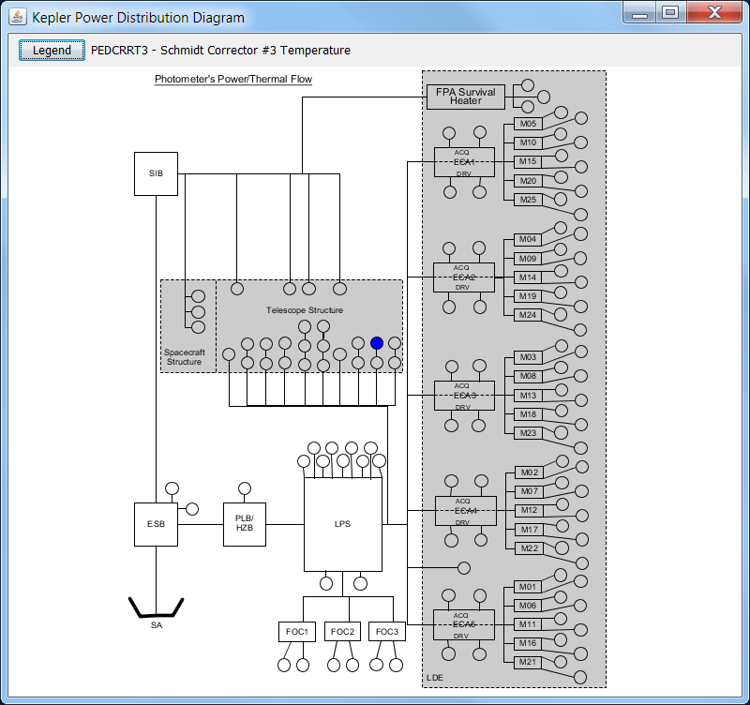
Intelliviz / Kepler Prototype
Notes:
Jim 1.5

Slide 18
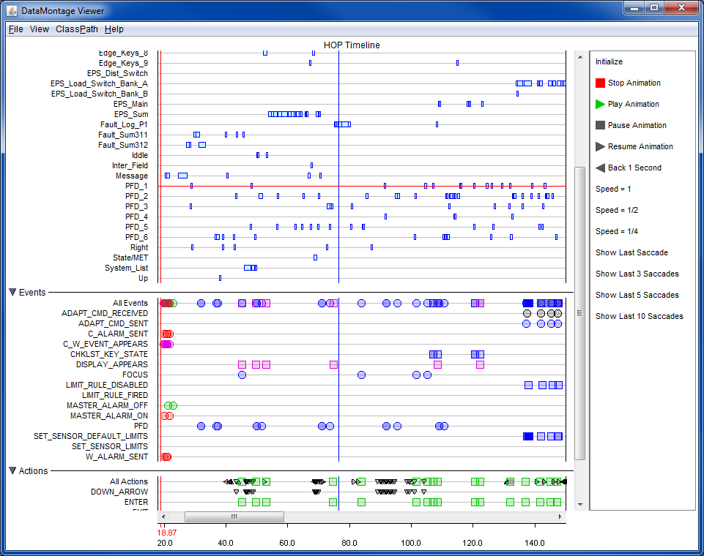
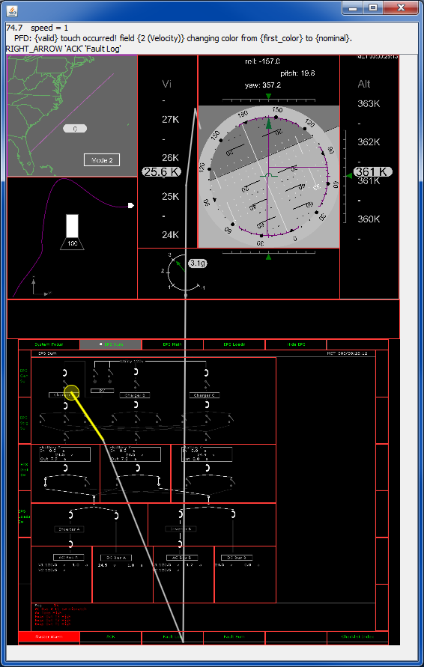
ACAWS Eye Movement Data
Notes:
Jim 1.5

Slide 19
Results
.
Arrays of graphs and timelines (DataMontage), integrated with spatial data displays, are effective for analyzing complex, spatial-temporal data more effectively.
Simple diagnostic reasoning + data visualization accelerates diagnosis and cross-checking by helping users detect, review, and interpret relevant data patterns more quickly.
Notes:
Jim 1

Slide 20
Technologies
.
DataMontage
Intelligent Diagnosis
Cross-checking
Modular Java software for visualizing complex, time-oriented data (TRL 9)
Proof of concept prototype that detects and displays important data patterns to accelerate cross-checking and diagnosis (TRL 6)
Notes:
Jim 1

