Slide 1
Deploying an Intelligent Pairing Assistant for Air Operation Centers
Hulten
Consulting
Jeremy Ludwig, Ph.D.
June 21, 2016
Distribution A: Approved for public release. 88ABW Cleared 05/10/2016; 88ABW-2016-2393.

Slide 2
Overview
Introduction
Design
IPA v1
Evaluation
IPA v2
Conclusion

Slide 3
Introduction
US Air Force Air Operation Centers
Planners create an Air Tasking Order
Use Master Air Attack Planning Toolkit (MAAPTK)
Challenge
Best use of available resources
Intelligent Pairing Assistant (IPA)
Integrates with MAAPTK
Pairs collection requests with existing missions
Requires as little additional training as possible

Slide 4
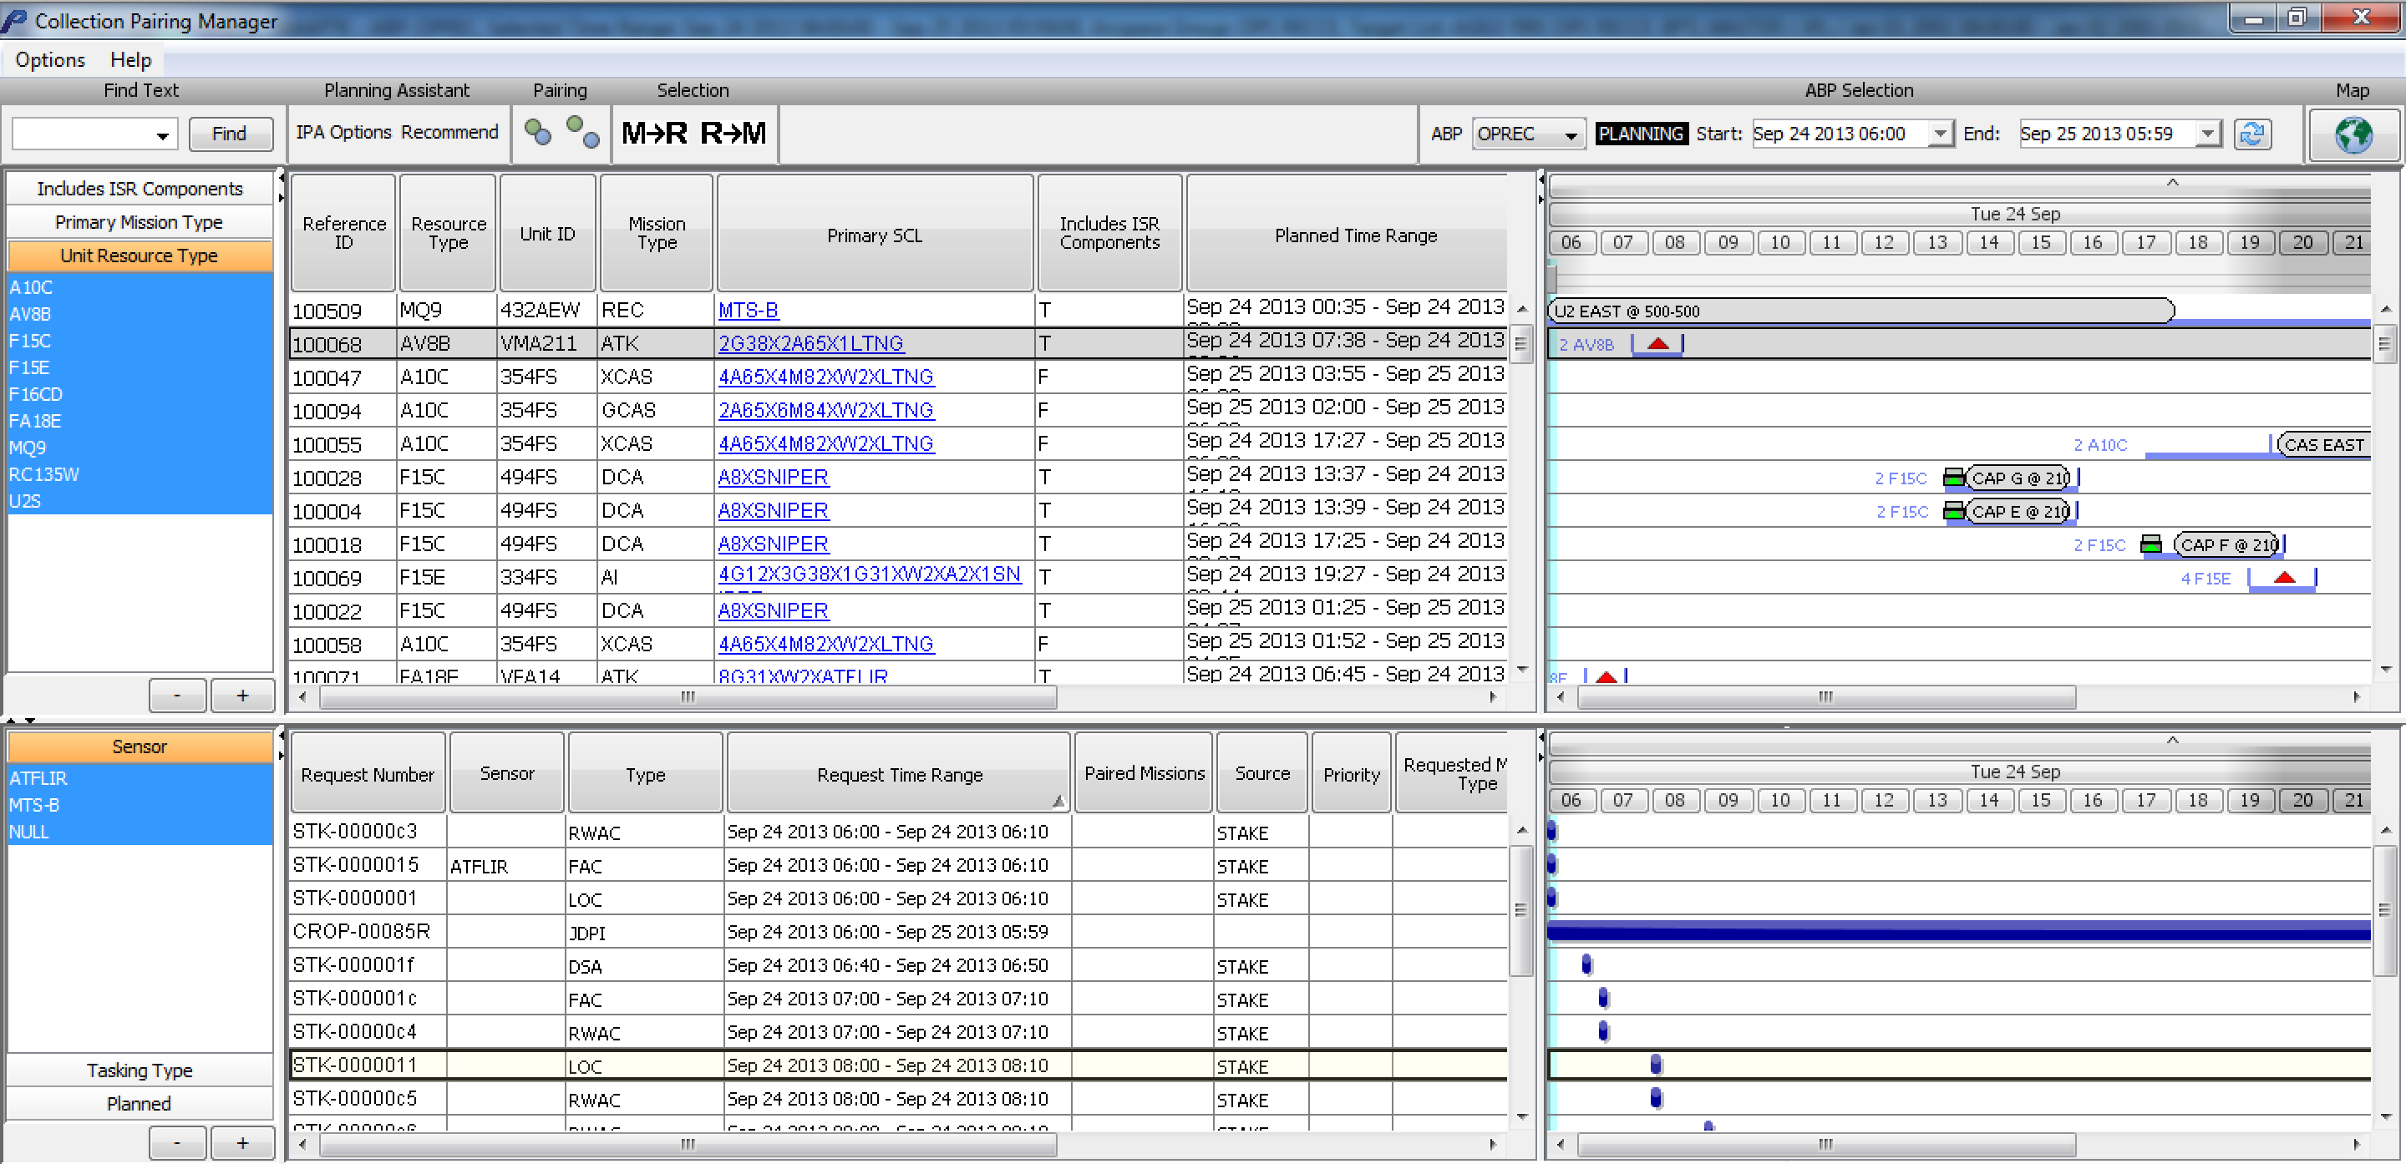
Collection Pairing Manager

Slide 5
Design
Knowledge Engineering
How does a planner use MAAPTK to pair collections with existing missions?
What do they need to know to select between possible matches?
Problem is harder than it looks at first glance!
Algorithms
How can we automate the search and analysis of information available electronically?
User Interface
How do we display the results to the planner in a way that makes sense and fosters trust?

Slide 6
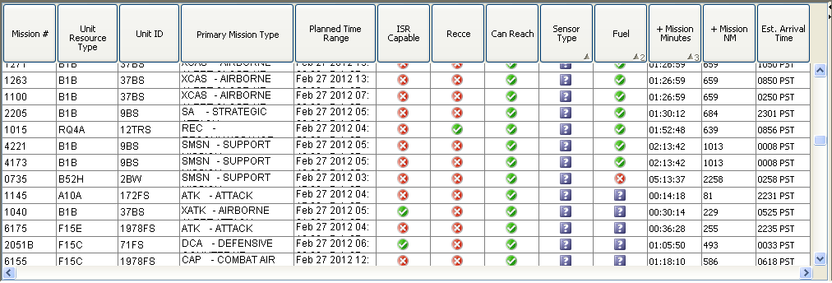
Intelligent Pairing Assistant v1

Slide 7
User Evaluation
Objectives
After initial training and a minimal amount of hands-on use, do users understand the information being provided by the IPA columns?
What information and format would users prefer for each column?
What other information would the users find useful?
Are the information content and format useful in supporting users for more efficient and accurate pairing?
Participants
Process

Slide 8
User Evaluation Results
Reduce Processing Time
Realistic Data Set
Move to Collection Pairing Manager
Collection table, default column widths and locations, filtering mechanism, improved map integration
Refactor Columns
Remove columns and replace w/ tooltips on remaining columns, verify fuel calculations
Address Confusing UI Aspects
? symbol, empty cells

Slide 9
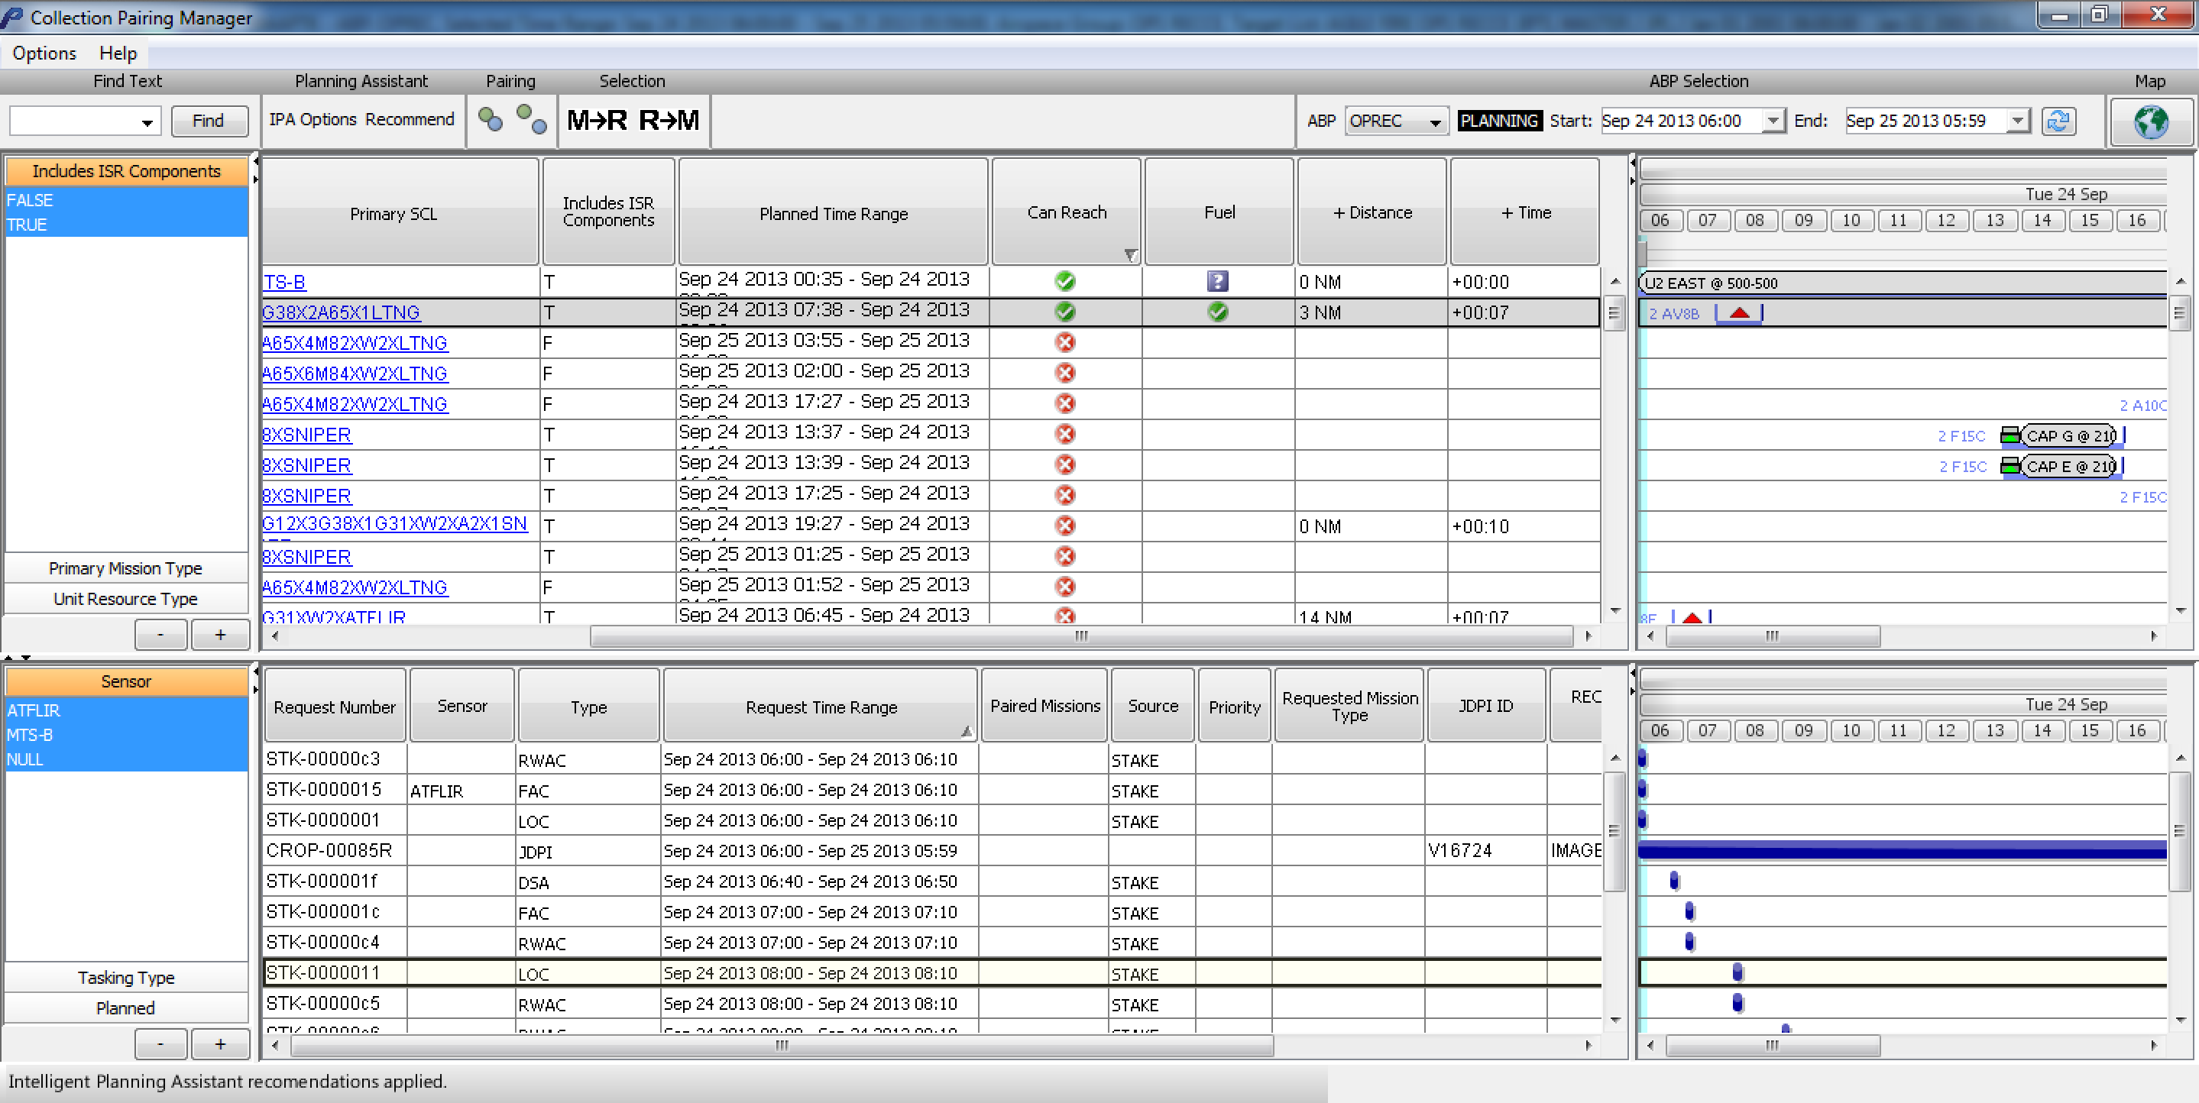
Intelligent Pairing Assistant v2

Slide 10
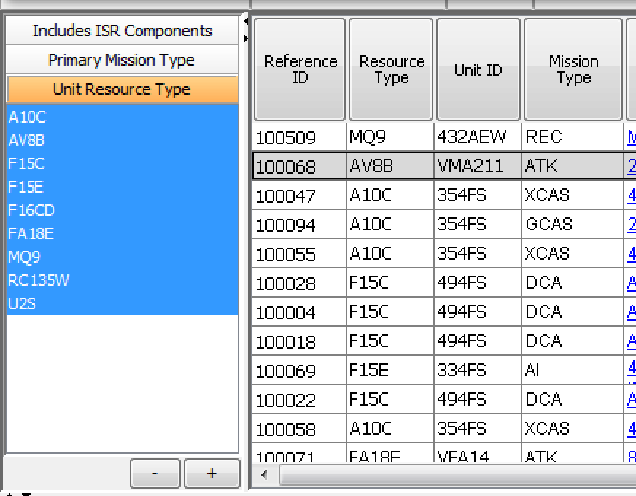
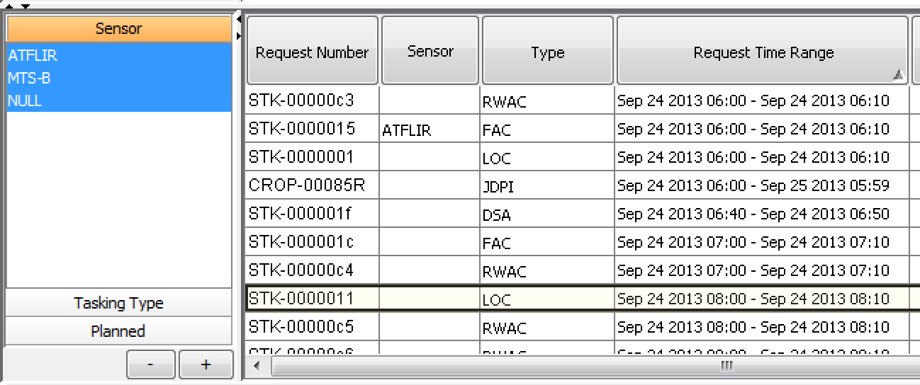
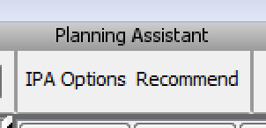
Process
Filter Missions
Select Collection Requests
Press Recommend
Review Results

Slide 11
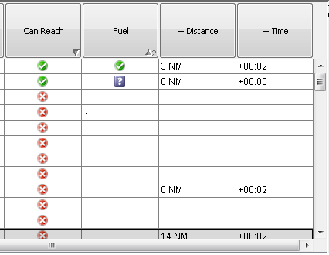
Recommendations
Can Reach
Fuel
+Distance
+Time

Slide 12
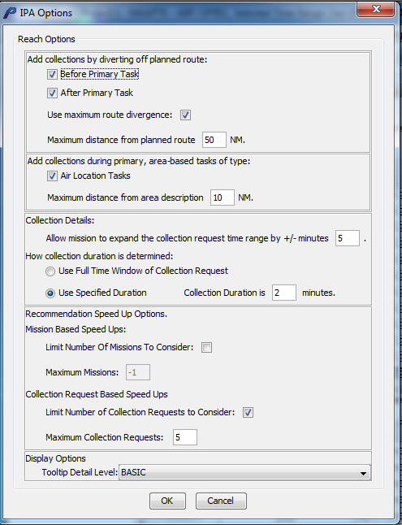
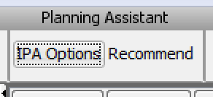
Customize Recommendations

Slide 13
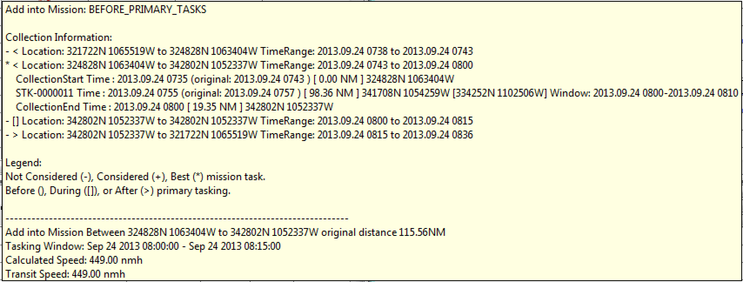
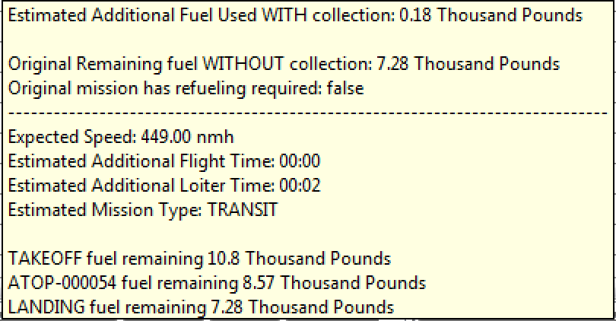
Additional Information: Understand Recommendations
Can Reach
Fuel
+ Time / + Distance

Slide 14
Conclusion
Example of specific pairing application
Matching collection requests to planned missions
Make it easier for the planner to do this specific task
Deployed to Air Operation Centers (AOCs) as part of operational software
Tested capabilities that meet evolving needs of the AOC
Future Work
Identify other areas in the existing MAAP and ISR planning software that could benefit from similar automation

Slide 15
Acknowledgements
This material is based upon work supported by the United States Air Force Research Laboratory (AFRL) under Contract No. FA8650-11-C-6220. The views, opinions, and/or findings contained in this article/presentation are those of the author/presenter and should not be interpreted as representing the official views or policies, either expressed or implied, of the AFRL.

